Slide 1

7023T
Advanced Database Systems
Session 07
Designing the Physical Database and Planning
for Performance
This presentation is based on Michael A. Fudge, Jr.

Slide 2
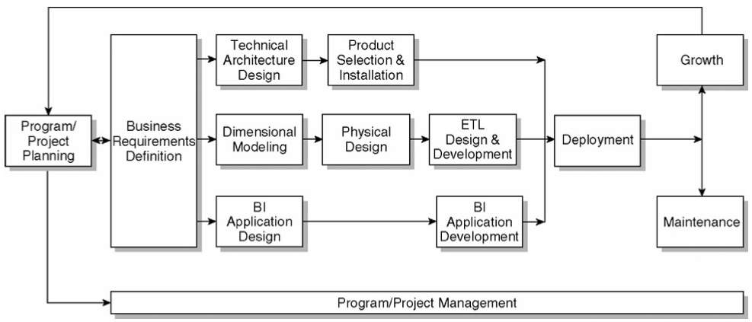
The Kimball Lifecycle Diagram

Slide 3
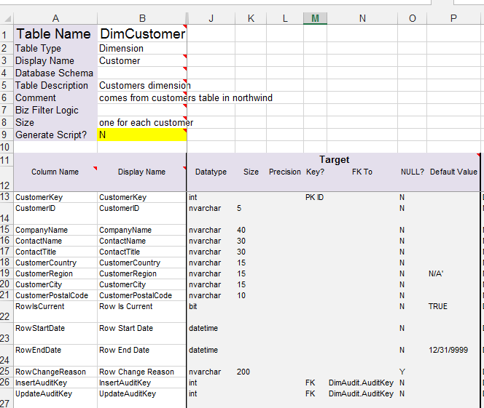
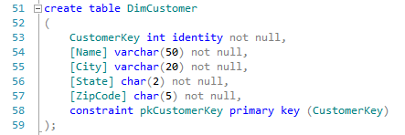
The Goal: Detailed Design to ROLAP Implementation

Slide 4
Outline
Describe the process of implementing dimensional model designs in a relational database (ROLAP)
Discuss approaches to implementation
Walk through an implementation together using a case-study, so you can see this in action!

Slide 5
The Physical Design Process
Design
Detailed Dimensional Model / Physical Model
Instantiate Relational Database
Develop Security, Auditing and Staging tables and Index plan
Design ROLAP Database & Test / Verify
Add Aggregations and improved Indexes
Finalize database Designs
Development Environment
Test Environment
Develop Standards

Slide 6
A word about Environments.
Networked so others can access it
Should be identical to prod in data and function.
Measure performance here.
Isolated to the Developers
Can use subsets of data
Not for “testing”
Test
Prod
Dev

Slide 7
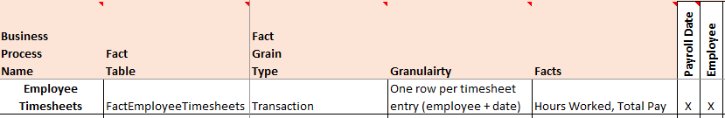
Case Study: Fudgemart Employee Time Sheets
We will:
Implement the ROLAP Schema
Load with data to test / verify the model
Let’s see the Detailed Design Workbook…

Slide 8
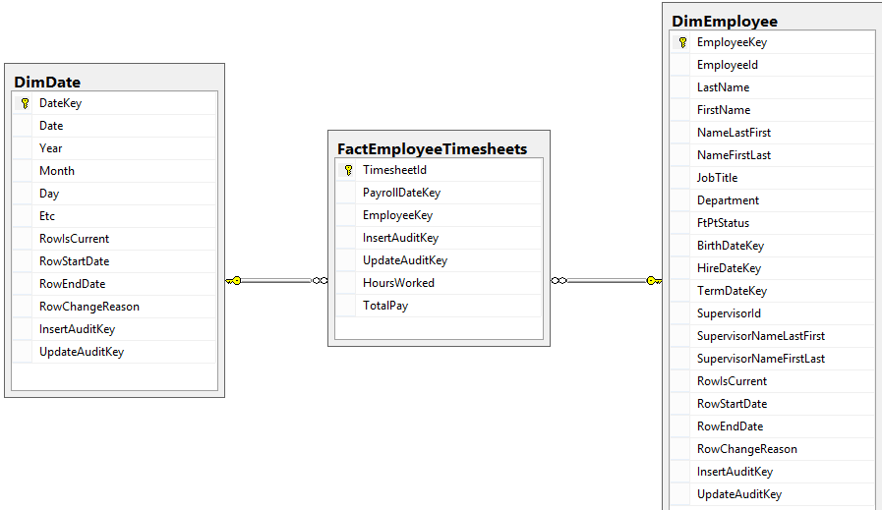
The ROLAP Star Schema

Slide 9
Developing Standards
Design
Detailed Dimensional Model / Physical Model
Instantiate Relational Database
Develop Security, Auditing and Staging tables and Index plan
Design ROLAP Database & Test / Verify
Add Aggregations and improved Indexes
Finalize database Designs
Development Environment
Test Environment
Develop Standards

Slide 10
Naming Conventions
Follow your organizations naming conventions
Develop them if you don’t have any!
Consistency is key here
Examples:
Customer_Dim
DimCustomer ⬅ We use this one
dim_customer
[Dim Customer]
Dim == Dimension
Fact == Fact Table
Stg == Staged Data

Slide 11
To Null or Not to Null?
The attributes in your dimension tables should not have nulls
Attributes without a value (null) should be assigned one
Example: No email? ➔ “No Email”
Null dates should get a special flag surrogate key
Foreign keys in the fact table should never be null
Nulls are okay for values in the fact tables.
We do this for the business users!

Slide 12
Synonyms & Views
Synonyms and Views are logical abstractions of tables and SQL SELECT statements, respectively.
For any table directly accessible by an end user a view or synonym should be used.
This way you can change the underlying tables without affecting the user’s external dependencies (Report, Web page, etc…)
CREATE VIEW name AS …
CREATE SYNONYM name FOR …
Notes:
Give quick demo:
create synonym customers for DimCustomer;
select * from customers
create view vProductSales as
select s.*,
p.size as ProductSize,
p.Color as ProductColor,
p.Description as ProductDescription
from FactSales s
join DimProduct p on p.ProductKey=s.ProductKey
select * from vProductSales

Slide 13
Primary Keys
Dimension tables should use Surrogate keys
Fact tables should use composite keys made up of dimension foreign keys and degenerate dimensions.
Most surrogate keys are number sequences date surrogate keys can be of the form YYYYMMDD
Surrogate keys can be used in the fact table but they increase the table size and do not improve performance.
Notes:
Demo:
Show how another customer would be added.
Show PK of the Fact table (by showing contents)
List contents of date table

Slide 14
Foreign Keys
Foreign keys are important. Don’t devalue!
FK’s enforce referential integrity between the PK in the dimension table and the FK in the Fact table.
This prevents you from inserting invalid data into the Fact table.
If you’re concerned about the performance impacts of constraint checking, you can drop the FK’s, insert the data, then reinstate the constraints with the nocheck option.
Notes:
(show diagram)
ALTER TABLE FactSales drop fkSalesCustomerKey
(show diagram)
ALTER TABLE FactSales with nocheck add
constraint fkSalesCustomerKey foreign key (CustomerKey) references DimCustomer(CustomerKey)

Slide 15
The Physical Model
Design
Detailed Dimensional Model / Physical Model
Instantiate Relational Database
Develop Security, Auditing and Staging tables and Index plan
Design ROLAP Database & Test / Verify
Add Aggregations and improved Indexes
Finalize database Designs
Development Environment
Test Environment
Develop Standards

Slide 16
Use Data Modeling Tools!
Useful for documenting metadata for tables and columns.
Produce reports based on the model and documentation.
Most tools generate the SQL required to create your model.
The Poor man’s option is Hand write the SQL… ☹
Examples:
Oracle SQL Developer Data Modeler
SAP Power Designer
CA’s ERWin
IBM Rational / InfoSphere
Microsoft Visio Enterprise Architect
MySQL Workbench

Slide 17
Is It Time to Use an SCM? Yes.
SCM ➔ Source Code Management
Git, Subversion, Mercurial, CVS
Time to get serious about an SCM, since you’ll be
Generating / creating code
Making lots of changes
Collaborating with others concurrently
CSM tools allow you to record and track changes to your code and easily roll-back versions and collaborate with others
Learn Git: http://git-scm.com/doc

Slide 18
Handling SCD’s in the Dimension Tables
Type 1 = No change to table required.
Type 2 = Require extra columns to your dimension table to track changes
Type 3 = Each time a change is made a new column need to be added to the dimension table.

Slide 19
Example: Type 2 Handling
Type 2 is the most common SCD
These columns should be added to assist with tracking, but not displayed to the end-user.
Add these columns:
RowIsCurrent (yes/no) → Is this the current row.
RowStartDate (datetime) → Start date of valid row
RowEndDate (datetime) → End date of valid row
RowChangeReason (text) → Explain why row changed
Notes:
ALTER TABLE DimCustomer
ADD
RowIsCurrent bit default(1) not null,
RowStartDate datetime default('1/1/1900') not null,
RowEndDate datetime default ('12/31/9999') not null,
RowChangeReason nvarchar(200) null;
select * from DimCustomer;
-- example: 'Derek-Smith' moves
-- always update first
update DimCustomer set RowIsCurrent=0,
RowEndDate = GetDate(),
[RowChangeReason] ='Change of Address'
where [Name]= 'Derek-Smith'
-- then insert
insert into DimCustomer ([Name],[City], [State],[ZipCode], [RowStartDate])
values ('Derek-Smith','Syracuse','NY','13244', getdate());
select * from DimCustomer;

Slide 20
Star – vs – Snowflake
Star Schema is preferred over snowflake as it is easier for users to understand.
If you need to snowflake, collapse your multi-valued / outrigger dimensions into a view.
Snowflaking makes it easier to attach fact tables at different grain.

Slide 21
Sizing Estimates
Need to know how must disk you’ll need.
Calculate row lengths for Fact & Large Dimension tables.
Estimate based on sizes of data types.
Come up with initial load size + scheduled ETL
Assume indexes will consume as much room as the base data.
A good rule of thumb
total space = 3 to 4 * Star Schema Size

Slide 22
Build Your Development Environment
Design
Detailed Dimensional Model / Physical Model
Instantiate Relational Database
Develop Security, Auditing and Staging tables and Index plan
Design ROLAP Database & Test / Verify
Add Aggregations and improved Indexes
Finalize database Designs
Development Environment
Test Environment
Develop Standards

Slide 23
Physical Modeling Checklist
Design the physical ROLAP structure (using your DMT or SQL)
Initial ETL Load (Not Automated with ETL Tooling)
Test and verify your data in the model
Finalize your Source-to-Target Map:
Check Naming Conventions for tables & columns
Name user-accessed views & synonyms
Verify data type & length of columns
Re-check your SCD types
Rules for replacing NULL with a default value
Add columns for maintenance and auditing purposes

Slide 24
Instantiate the ROLAP Database
You’ll need this before you can develop the ETL process.
You don’t need to focus on performance at this point because you don’t know the bottlenecks.
The Development environment should be separate from the test environment.
Use your SCM tool to manage code changes as you make them
And update your documentation!

Slide 25
Add An Auditing Dimension
An Audit Dimension is a special table for tracking the ETL process.
Each time the ETL process is run a row is added to the audit dimension table.
Each Dimension and Fact table gets two more columns
InsertAuditKey → Which process loaded this row
UpdateAuditKey → Which process changed this row most recently?
Will explore this while covering ETL.

Slide 26
Initial Stage + ETL
To verify your ROLAP model, you’ll need to populate it with data.
Initial Stage and ETL are typically done with SQL Queries
If the data volume is too large, use sub-sets of the source data.
You’re still exploring and validating your ROLAP Star Schema.
Take the lessons learned as you profile for automating the ETL process to come.

Slide 27
Best Practices for Staging Data
Always stage your data “as is” to avoid a dependency on the source systems.
You do not want your stage data in the same database or schema as your data warehouse.
Helps keep the models “tidy”.
On your Server, you’ll notice you have Stage and DW for this reason.

Slide 28
Security Tables
Security tables are used to filter row data based on user access or group access.
For example: Current user is a member of Store 102, so she only sees Sales for that store.
In SQL Server we use SYSTEM_USER to Id the user. All DBMS’s have a means to do this.
Notes:
-- security table
create table UserStores (
SystemUser varchar(100) not null,
StoreNumber smallint not null,
constraint PkUserStores primary key (SystemUser, StoreNumber)
);
insert into UserStores values ( SYSTEM_USER, 102);
select * from UserStores
-- now we create a view
create view vSales as
select s.*
from FactSaless
join DimStore d on d.StoreKey = s.StoreKey
join UserStores u on u.StoreNumber = d.StoreNumber
where SYSTEM_USER = u.SystemUser
select * from vSales;

Slide 29
The Test Environment
Design
Detailed Dimensional Model / Physical Model
Instantiate Relational Database
Develop Security, Auditing and Staging tables and Index plan
Design ROLAP Database & Test / Verify
Add Aggregations and improved Indexes
Finalize database Designs
Development Environment
Test Environment
Develop Standards

Slide 30
Test Environment
This is the point where end-users enter into the process.
Your system will be loaded with data so you will be able to monitor usage and adjust performance accordingly.
Your test environment is separate from your Development environment.
It should be network accessible.

Slide 31
Indexing Dimension & Fact Tables
If your DBMS supports bitmapped indexes, add them to your dimension tables on attributes involved in row filters.
Bitmapped indexes are good for low-cardinality columns (Y/N or High, Med, Low)
Supported in Oracle, not SQL Server
For fact tables, follow the index plan optimizer of your DBMS.
Notes:
Build a visual view of vSalesMart in GUI view builder then run the view with Actual Execution Plan on.

Slide 32
Aggregations
Aggregate popular rollup data.
Monitor queries to find out what’s popular.
Improves performance.
FactSales
Date Key PK,FK
Product Key PK, FK
Sales Amt
Sales Qty
DimDate
Date Key PK
Date Name
Year-Month
Year-Qtr
….
DimProduct
Product Key PK
Product Name
Product Color
Product Subcat Key
Product Subcat
….
FactSalesSummary
Year-Month Key PK,FK
Product Subcat Key PK, FK
Sales Amt
Sales Qty
Rollup

Slide 33
Summary
Develop standards for consistency
Use data modeling tool to help document the physical design.
Use a SCM tool to track changes to your design.
Add to your schema to support Type 2 & 3 dimensions.
Include a framework for auditing the ETL process.
Build and verify your model in Development
Introduce users during the test phase.

